Slide 1
Why brands are more important than ever: Brand driven growth in the age of AI and disruption
4 December 2025

Slide 2










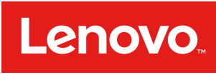




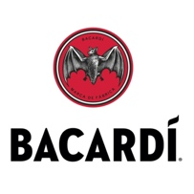



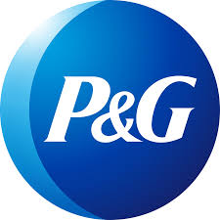










Working with many famous brands

Slide 3
What we believe… Brand is a source of financial value whose potential is untapped

Slide 4
What Presciant stands for…
We help companies maximize the power of their brands to gain a financial edge over competitors, & drive revenue, profit & business value growth

Slide 5
BRAND MATTERS

Slide 6
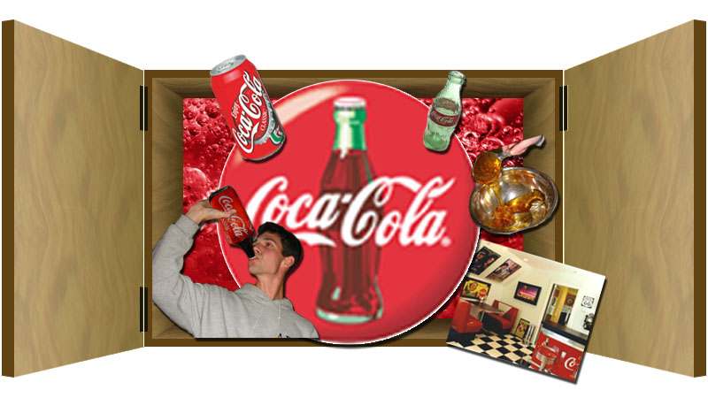
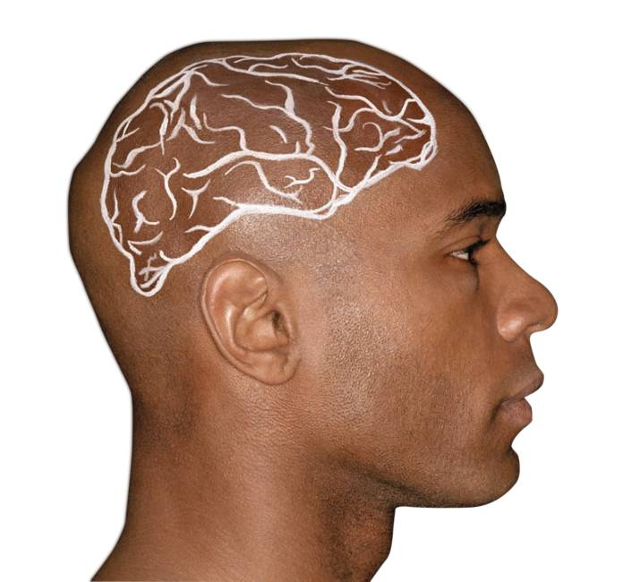
Brands shape customer behavior
How a brand works:
Creates a set of associations and an emotional relationship with a company or product
Which leads people to prefer it over competitors’ products
Drives their choice and purchase decision
And generates an additional flow of sales and profits
“The reputations of the most valuable brands are built on promises which have a higher purpose. They go beyond the product, beyond the category, to stand for a universal human idea. The unique power of brand lies in its ability to transfer loyalty across products, service and categories.”
- The Brand in the Boardroom, Joanna Seddon

Slide 7

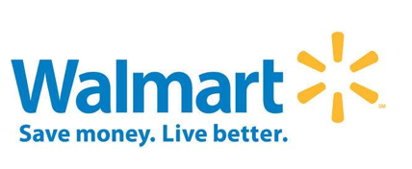


Brand drives a price or volume premium and sometimes both
Positive price premium and positive volume premium
Negative price premium more than offset by a positive volume premium
Highly positive price premium offsetting a negative volume premium
Has been targeting a broader consumer segment in order to generate further growth; the brand lowered its price premium through lower-end product introductions, thereby generating a higher volume premium

Slide 8
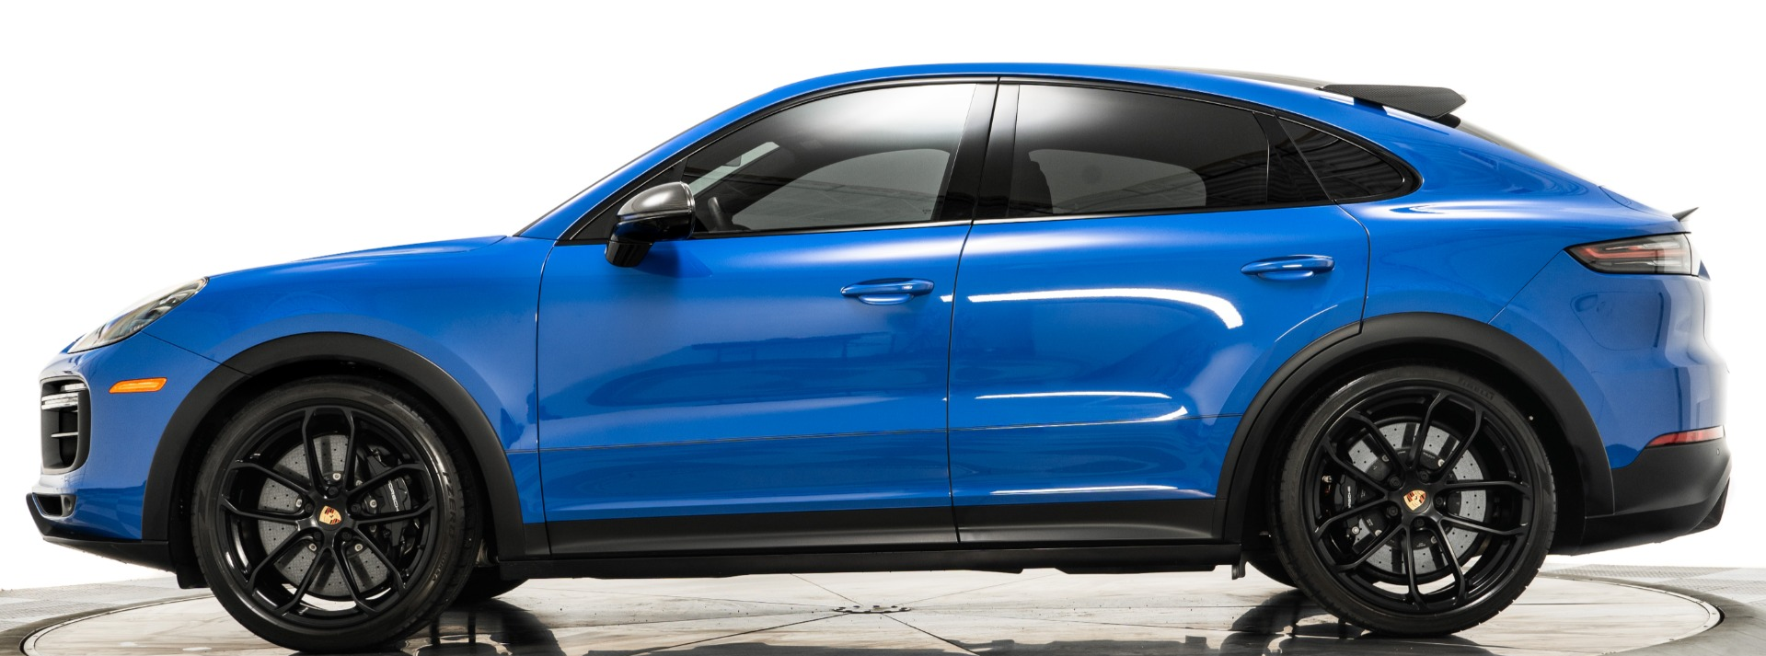

Brands shift the demand curve
Stronger brand equity drives higher prices and greater share
Price
$42,200
Porsche Cayenne
$38,110
Volkswagen Touareg
Quantity
US Sales
8,812
12,547
Source: Automotive News

Slide 9

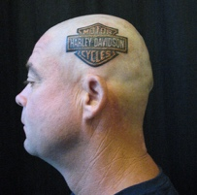
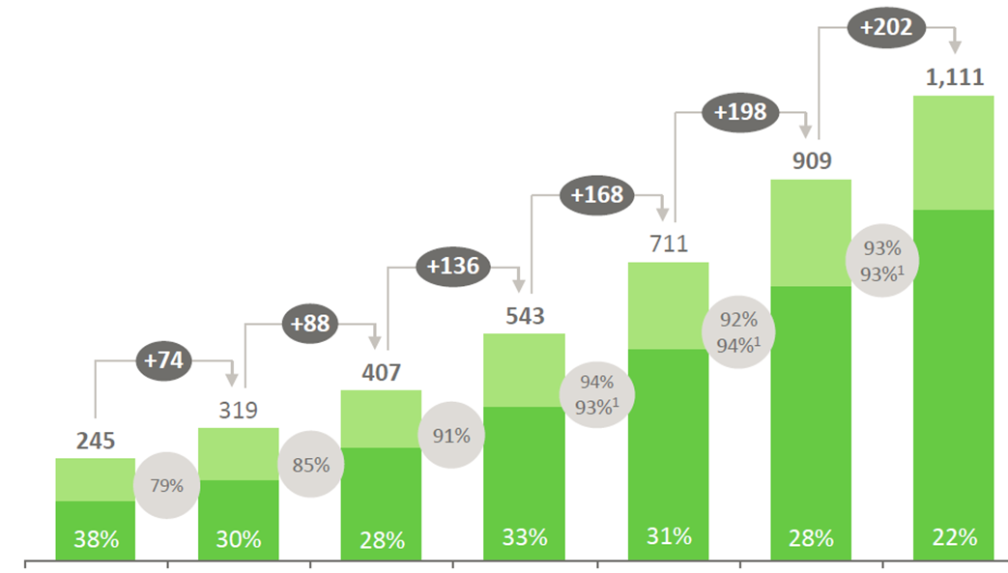
Brands create loyal customers
Retains customers and attracts new ones + Edge over competitors
A strong brand drives customer retention, loyalty and advocacy, and attracts new ones
A strong brand creates an edge over competitors, defends and drives market share
Repeat customers drive more sales than new customers
The Harley-Davidson brand
Sales ($m)
New customer sales (1st year)
Motorcycle market share
All others
Harley-Davidson
Repeat customer sales
Huffy
Yamaha
Polaris
Dorel
Sales growth vs. previous year
Has leveraged its almost religious brand equity among loyalists to survive an onslaught by functionally superior brands such as BMW
Year 1
Year 2
Year 3
Year 4
Year 5
Year 6
Year 7
On average, 20% most Loyal Customers = 80% of Sales
Source: Annual report

Slide 10
A strong brand is a major component of shareholder value
Over 80% of stock market value is represented by intangible assets, not the tangible plant, property and equipment
Brand is one of the most important intangible assets, contributing around 1/3 of market cap.
Brand is a major financial asset and should be treated like any financial asset
Source: Ocean Tomo, Kantar BrandZ

Slide 11
MANY PEOPLE THINK BRANDS DON’T MATTER ANYMORE

Slide 12
Digital has been undermining the role of brand for a long time
Percent of total marketing budget (2025)
It’s all about performance marketing—you can measure results immediately in bits and clicks
Brand marketing
Performance marketing
Source: 2025 MMA Global / Adobe Survey, Gartner
Notes:
Performance marketing has tremendous appeal for managers focused on reporting this quarter’s results
It’s trackable and ROI-driven
Brand marketing has a much bigger impact on value creation, short-term, medium-term and long-term
But its effects are much less visible, much less easy to measure and demonstrate
Spend has shifted away from the traditional rule: 60% brand building, 40% performance marketing
Marketing leaders prioritize performance marketing 2.5% more often than brand

Slide 13

AI is said to be finishing brands off
Everyone can do everything
There’s a multiplication of brands
Anyone can create a product

Slide 14
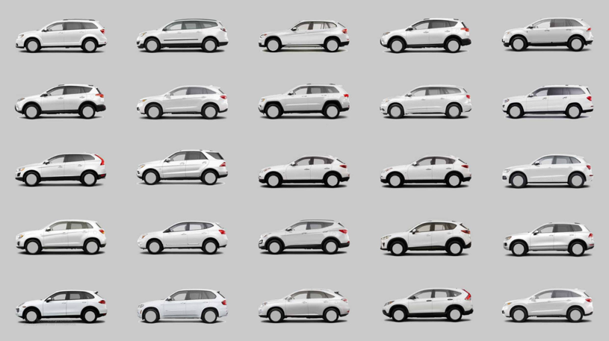
Everything looks alike
Everyone can find out what makes the best experience
So, everything looks alike
It doesn’t matter which you buy
Source: Kantar
Notes:
AI is going to democratize all the best practices, so now everybody can come up with the best car.
They pretty much look all alike. Well, why is that? It's because the law of physics applies to every car.
So if you're designing a car for best gas mileage, there's only one way to design it. The law of physics is not different for Ford than it is for Toyota.
So there's the paradox. They're all better quality.
But the difference between them has shrunk. And that's occurred in every category. Products in every category these days are better than they were in the past.
And once a particular brand finds out a better way to do something, competitors go, I'm going to do it too.
So now everybody's doing the same thing. So as quality has gone up, the difference between brands has shrunk.

Slide 15
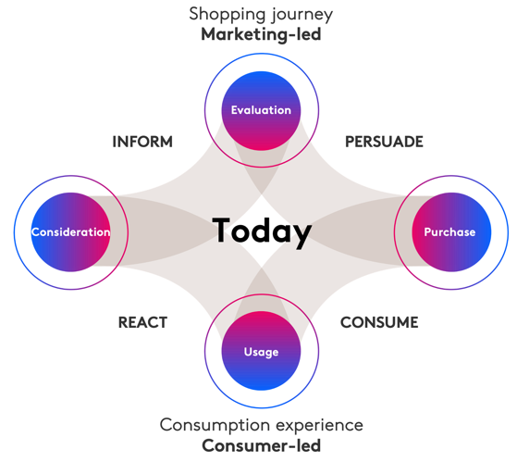
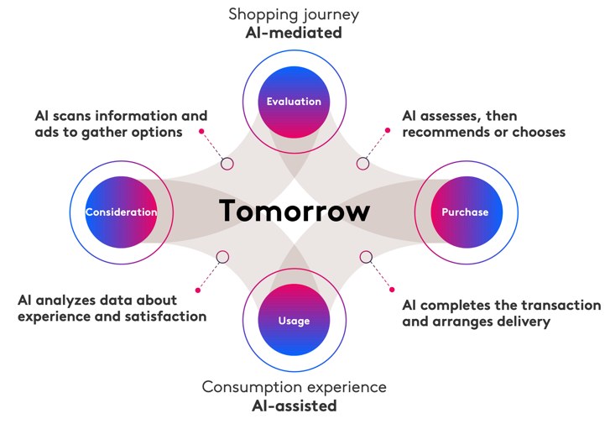
Shopping is increasingly informed by AI
People aren’t making decisions on their own, they get help from AI shopping apps and ads
Human People Do It
Human+ AI Does It
Source: Kantar

Slide 16
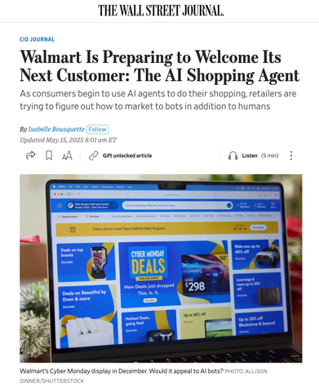
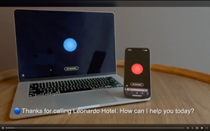
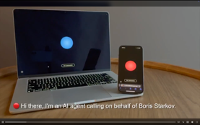




Consumers are going to be completely disintermediated from brands
The future is about transactions between AI agents, with no humans involved
Tomorrow’s customer
Advertising to algorithms
1
2
Thanks for calling Leonardo Hotel. How can I help you today?
Hi there. I’m an AI agent calling on behalf of Boris Starkov.
3
Before we continue, would you like to switch to GibberLink mode?
4
Oh, hello there! I’m actually an AI assistant too.
5
Catering? Decoration? Room blocks?
What’s needed?
6
Great. Much Faster! Guest count?
25 adults
All of the above. What are your rates?
Source: Kantar

Slide 17
BRANDS NOW MATTER MORE THAN EVER

Slide 18
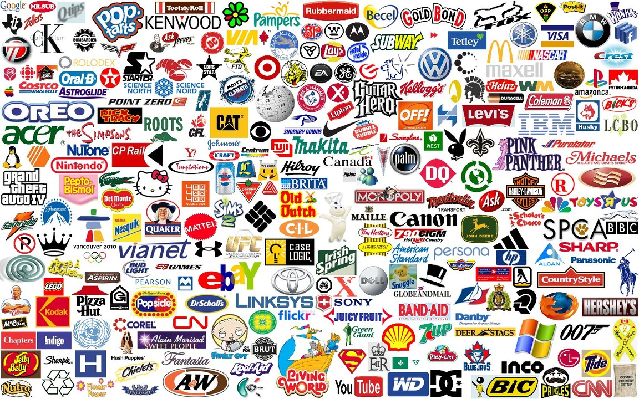
With AI, almost anyone can create a brand It’s become much more difficult to stand out

Slide 19





Big Tech brands are so strong, they are killing off potential competition
Network effects
Control of key digital infrastructure
Massive user-behavior datasets
Acquisition of emerging competitors
Acquisition of emerging competitors
Notes:
1. Network effects
Platforms like Google, Amazon, Meta, Apple, and Microsoft become more valuable as more people use them. This creates a self-reinforcing cycle that makes it extremely hard for new entrants to gain scale.
2. Data advantages
Large platforms accumulate massive user-behavior datasets, enabling better targeting, personalization, and product refinement—giving them a structural edge that startups cannot match initially.
3. Control of key digital infrastructure
Apple and Google effectively control mobile ecosystems. Amazon controls a huge portion of e-commerce logistics and cloud hosting. Microsoft dominates enterprise software and productivity stacks. This creates gatekeeper power—they can set fees, determine access, and prioritize their own products.
4. Acquisitions of emerging competitors
For years, big tech firms acquired potentially competitive startups (Instagram, WhatsApp, YouTube, GitHub, LinkedIn, etc.). This limits the number of companies that can challenge incumbents at scale.
5. Bundling strategies
Examples:
Microsoft bundling Teams with Office
Apple bundling services into Apple One
Amazon bundling Prime shipping, video, music, cloud storage Bundles make it extremely hard for point-solution competitors to survive.

Slide 20

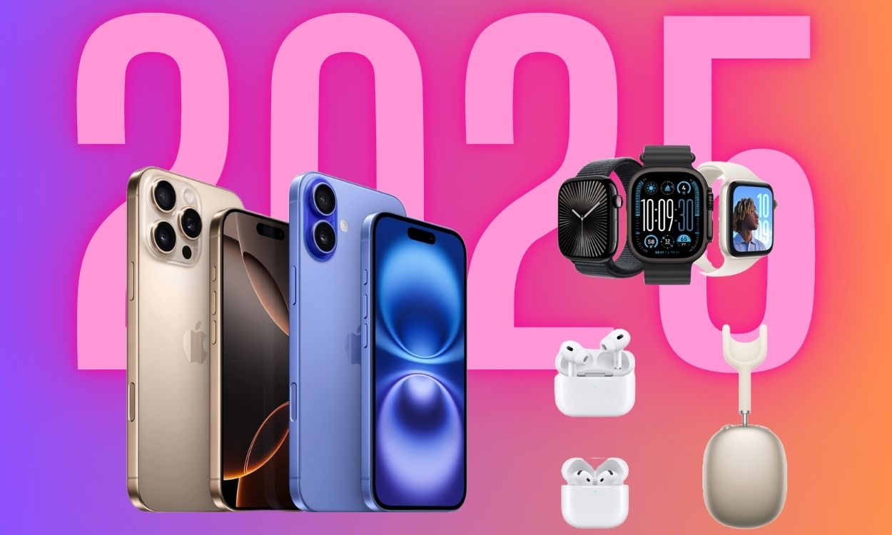
Why? Brand is much more than communications
It’s about servicing the customer in many ways that are different, providing products tailored to their needs and, above all, innovating
Mktg & Comms
Product Offering & R&D
Customer Service
Brand Strategy
Operations & IT
HR

Slide 21



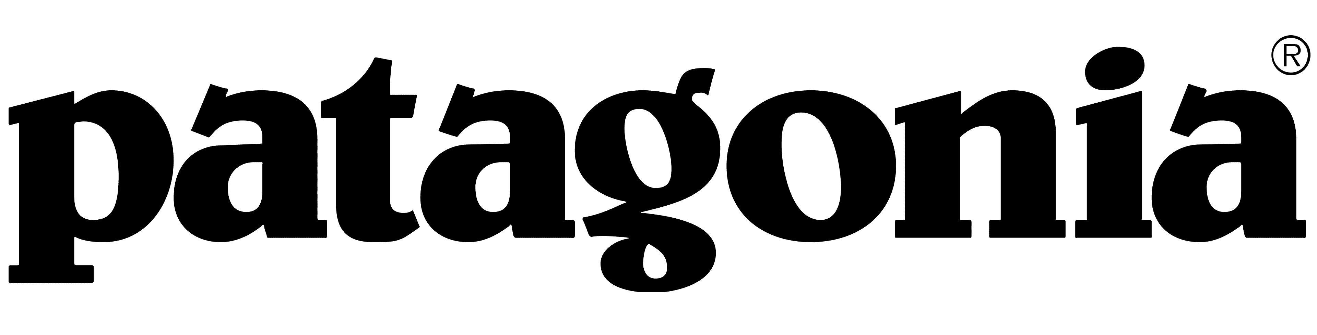
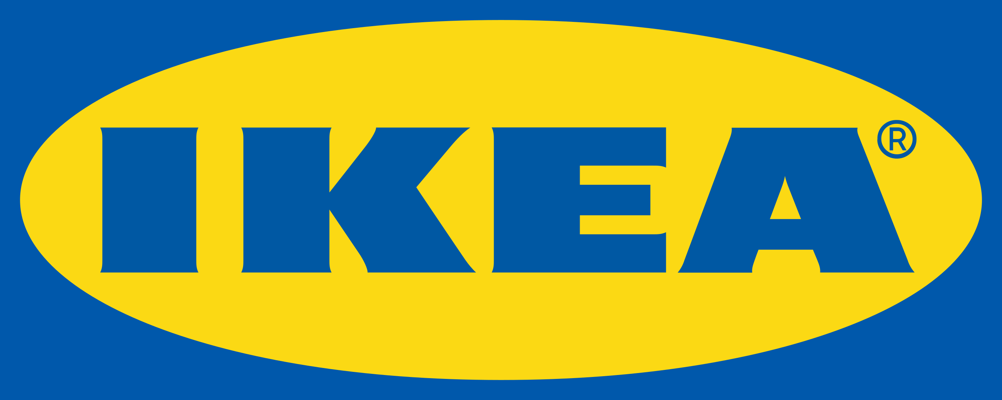

In a world of identical choices, people will rely on brands more than ever
Differentiated and successful brands
The competitive advantage of standing out will be multiplied many times
Design and simplicity
Inventing an entire category
Early bet on streaming
Radical purpose
A DIY experience
A third place

Slide 22
HOW TO UNTAP THE HIDDEN VALUE OF BRAND IN THE ERA OF AI

Slide 23
Use AI to improve your brand differentiation
How you differentiate your brand and create your marketing and innovation strategy and investment plan can be more accurate, more efficient, and more effective with AI
Use AI to make your consumer research better, your product better, your operations more efficient, your customer service better
Apply AI to get closer to understanding the real motivations, needs, pain points, aspirations of the customers you have and the customers you want
Leverage AI to make your research better—look at many more customers and understand at a greater depth
Identify the differences between customers at a micro level, and tailor and shape your offering and messaging, personalizing them down to the individual customer level
Learn from the companies that are already doing this

Slide 24









Learn from companies already applying AI for competitive advantage
70% of what people watch on Netflix comes from recommendations made by AI
Analyzes browsing, purchases and interactions to surface products for each customer
Chatbots have boosted customer satisfaction by 15%, reduced wait times and improved operational efficiency
Analyzes wait times, purchases and sentiment to optimize the park experience
Analyzes banking activities, and demographics to predict each customer’s future needs
Uses AI to generate alerts, personalize feeds, and create videos in response to a prompt
Has increased click-through rates by 20% and improved brand perceptions by personalizing ads
“Sparky” genAI assistants personalize shopping, adjusting pricing and creating customized home pages for each user
Personalizes make-up and skin recommendations, leveraging AI + augmented reality
Uses predictive analytics and AI to offer curated drops based on individual behavior and preferences
Notes:
Netflix: Deploying AI to understand individual consumer preferences and serve up new content to them.
Tailoring the offering they serve up to different customers and communicating them in a way that hits their particular buttons and pain points: (e.g., P&G is requiring every one of their employees to be qualified on AI, and anyone not will be let go)

Slide 25
THE RESULTS—LASTING SUCCESS AND GREATER COMPANY VALUE

Slide 26
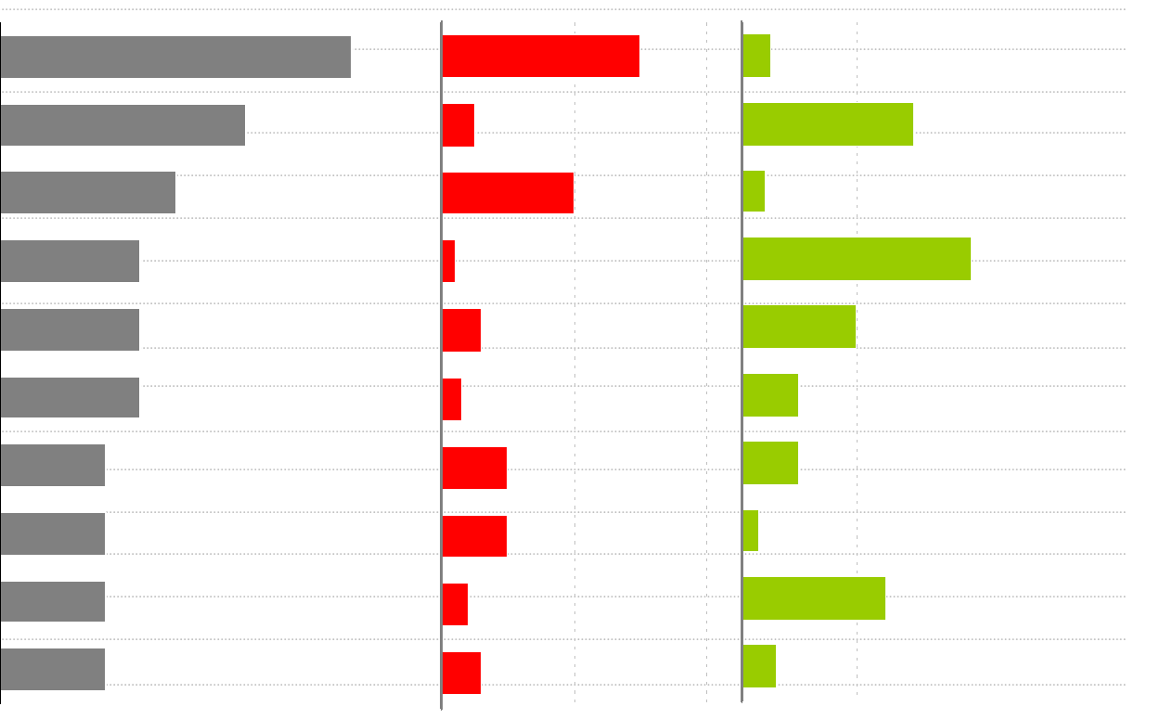
Grow your revenues
AI can help you address your customers’ needs more precisely by pulling the right levers for customers
This will create more and more loyal customers who are more profitable than new customers, while continuing to funnel new ones your way
Measure How the brand creates value
Brand Driver Analysis
Relative importance
Brand impact
Brand A
Brand B
Is a Leader
Quality of service
Service Coverage
Cool Features
Data Plan
Price/Value
Handsets offered
Existing Relationship
Third Party Reviews
Customer service
Notes:
Brand A is a leader, but Brand B has better quality of service and cool features
If Brand A wants to improve customer attraction and retention, and grow its revenues, it needs to get its brand better known for quality of service and cool features

Slide 27
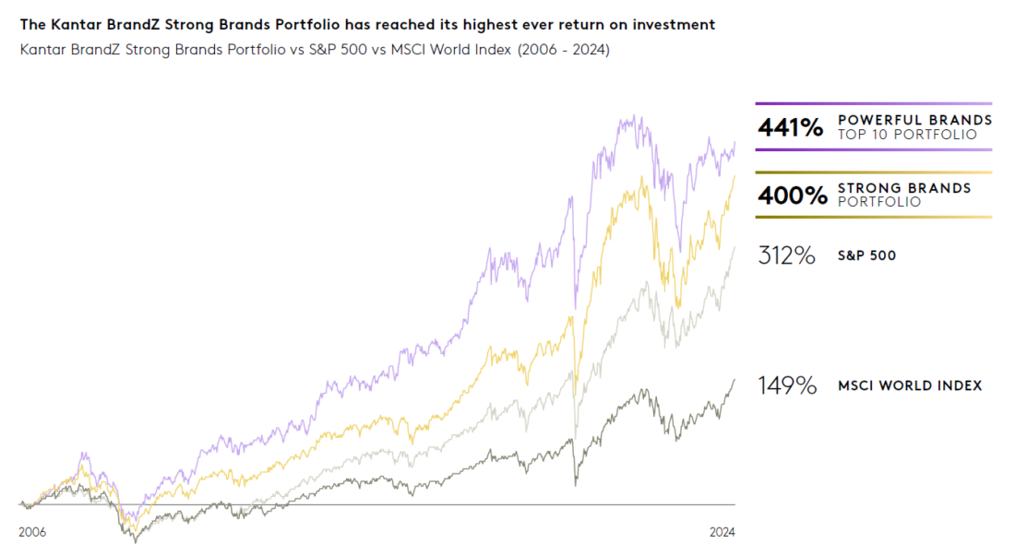
The result will be an increase in your shareholder value
Using AI to improve your brand experience will grow revenues and profits, and increase your financial value
Companies with strong brands outperform the market

Slide 28
Thank You
Joanna.Seddon@presciant.com
Nikhil.Gharekhan@presciant.com

